Slide 1

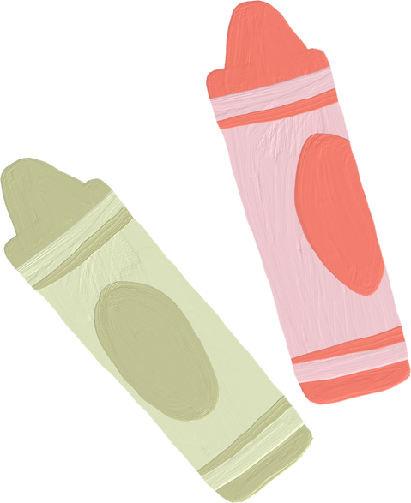


STARTING SCHOOL
TEYNHAM PRIMARY
SEPTEMBER 2025

Slide 2


Our Team
Mrs Geeves
Class teacher
Mrs Bilton
Mrs Axten
Mrs Glover

Slide 3

School Routine
Drop off at gate outside classroom.
Gates open at 8.40 am
Lunch 12pm
Hometime 3.15
Pick up from gate outsde classroom.

Slide 4
Ready for school
  I am practically ready
  I am ready to communicate
  I am physically ready
  I am socially ready
  I am emotionally ready

Slide 5

I am practically ready
1
2
3
I can open my packed lunch box and eat independently
I can use a knife and fork
I can sit at a table when I eat.

Slide 6
I am practically ready
4
5
6
I have practised getting my uniform on and being ready to leave in time.
I have a good bedtime routine so I get enough sleep.
I am making sure I have breakfast before I come to school.

Slide 7



I am ready to communicate
I enjoy interacting with others.
I am able to talk about myself , my thoughts and feelings
I am able to sit and listen for a short while.
I enjoy sharing stories
I can follow instructions.
I am understood when I talk.

Slide 8
I am physically ready
1
2
3
I am able to use the toilet independently.
I can wash my hands
I can get dressed and undressed

Slide 9
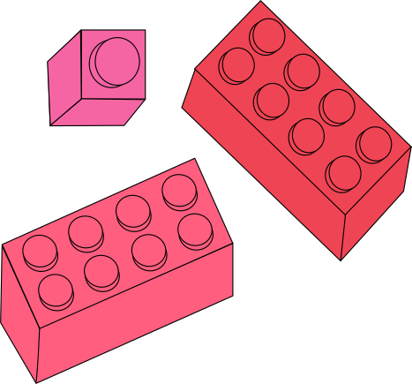
I am physically ready
4
5
6
I am able to use the toilet independently.
I can move around confidently (walk, run and jump)
I have good muscle control in my arms hands and fingers

Slide 10
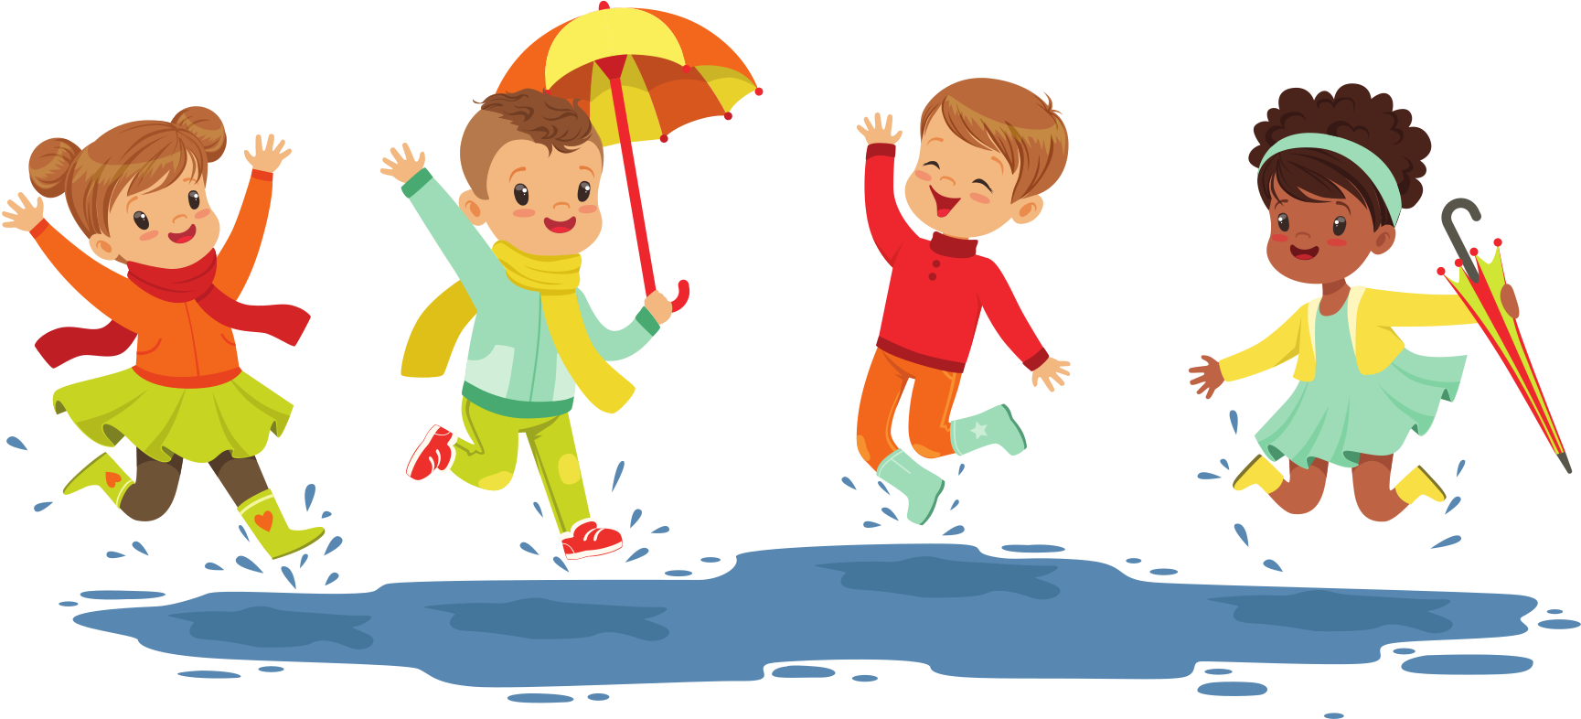
I am physically ready
7
8
I have good balance
I am confident with climbing, jumping and running

Slide 11
I am socially ready
I am able to take turns.
I am able to share with others
I enjoy interacting and playing with others.
I am good at making friends with others.

Slide 12
I am emotionally ready
1
2
3
I am confident being away from my Mummy, Daddy or main carer
I am willing to have a go at new activties
I am able to identify how I feel and share it with others

Slide 13

I am emotionally ready
4
5
I keep trying when I find things difficult.
I am know who to ask for help if i I am unsure

Slide 14




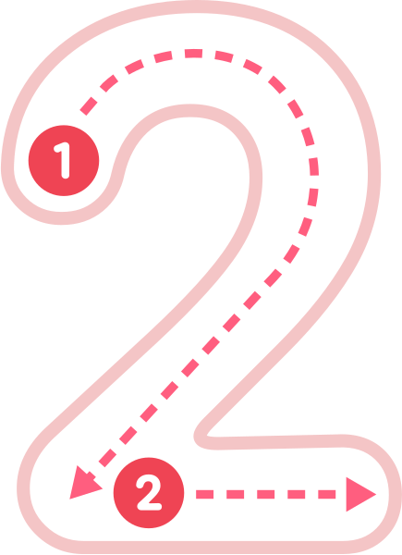

Academic extras
  I can recognise my own name.
  I am aware of numbers and counting
  I join in with counting, number songs and number play.
  I experiement with emptying and filling containers
  I can recognise some numbers (up to 5)

Slide 15

THANK YOU

